Slide 1
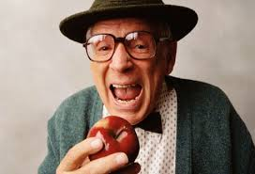
Nutrition in the Elderly
Patty Harris, MD
Carolyn Kaloostian, MD, MPH
Jo Marie Reilly, MD, MPH
2018

Slide 2
Objectives
Review the, basic biology/physiology of aging related to nutrition & malnutrition and its incidence in the older adult
Review common issues that impact adequate nutrition in the older adult
Discuss macro and micro nutrients and deficiencies that should be considered and screened for in the older adult to optimize health
Discuss a simple nutritional screening tool that may facilitate better older adult nutritional screening

Slide 3
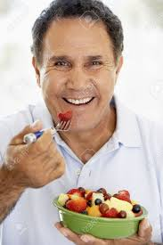
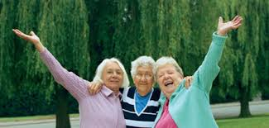
Older Adult Physiological/Biological Digestive Changes
Changes in healthy older adults:
Neurodegeneration of the aging gut nervous
system (dysphagia, reflux, constipation)
Decreased gastric secretions with aging
Appetite and food consumption declines-less hungry, fuller between meals, eat more slowly, consume smaller meals
”Anorexia of aging”-net
body weight loss
Decreased taste and
smell
Notes:
Average daily intake of food decreases up to 30% between 20 and 80 years old
Anorexia of aging-decline in energy expenditure with age is overcome by the decline in energy intake (eat less but don’t cut down on activity enough to compensate for it)

Slide 4
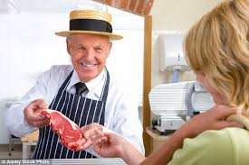
Older Adult Changes in Body Weight/Composition
Changes with healthy elderly:
With age, loss of up to 3 kg (6.6#) of lean
body mass per body mass decade
after age 50.
This leads to an increase body fat (intra-hepatic and intra-abdominal)
*Net Decline in skeletal mass-sarcopenia
Notes:
Cause is multi-factorial-decreased physical activity, decreased resting metabolic rate, diminished sex hormones and reduced growth h0rmone secretion

Slide 5
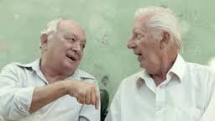
Psychological/Social Issues in Older Adult Nutrition
Psychological
Delirium
Dementia
Depression/anxiety/bereavement
Alcoholism
Social
Poverty
Isolation
Inability to shop/prepare and cook food

Slide 6
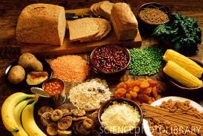
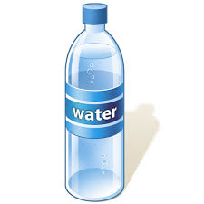
Common Issues that Impact Older Adult Nutrition
Hydration-30 ml/kg body weight
Mobility
Teeth
Fiber
Chronic illnesses and medications for them
Reduced Income
Notes:
Hydration-decreased thirst perception, diuretics for htn, reduced glomerular filtration rate and renal impairment
Mobility-don’t move, don’t burn calories, poorer gut motility, constipation and can’t get to store to get food or can’t move arms to get spoon to mouth
Teeth- don’t have them , mouth pain, denture don't fit, can’t chew foods; older people in general have decreased oral intake
Fiber-eating softer foods don’t give fiber so get constipated- need to review high fiber foods
Chronic illness-assess impact of medications and chronic illness on diet and nutrition, PEG tubes, stroke patients, physical inability to feed self
Reduced income-can’t afford food, fixed income-food or rent?

Slide 7
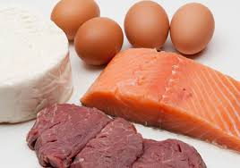
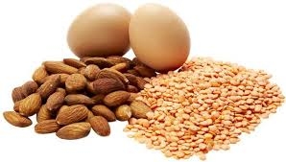
Protein Needs in Older Adults
RDA minimum for protein regardless of age is .8 gram protein/kg a day
RDA of 1.5 protein/kg a day for elder adult is optimal to improve health function (about 3 oz with each meal daily)
Amount and quality of protein intake decreases with age
Notes:
RDA is to minimum to prevent progressive loss of mean muscle mass; In older adult want to exceed this to improve muscle mass , strength and function

Slide 8
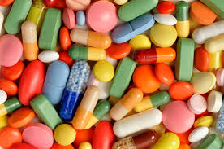
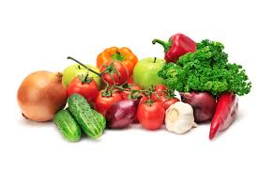
Macro and Micro Nutrient Needs in Older Adults
Reduced Vitamin D and calcium-(decreased sun
exposure, thinning of skin and reduced skin production
Increased calcium needs Post-menopausal women not on estrogen need 1500 mg/calcium daily
Vitamin B-12 deficiency - 12-14% of community dwellign/25% of institutionalized older adults
Folate deficiency –Up to 50% decreased in older adults, higher if institutionalized
Vitamin C-150 mg men and 75 mg women
Zinc, selenium, copper, chromium and manganese levels/needs are unchanged with healthy aging
Older people do not clear Vitamin A well-hypervitaminois
Notes:
Calcium and vit D most problematic in women at risk for osteoporosis
1 qt milk as 400 iu Vit D - recommendation is 600 iu/day or 1.5 qts milk (!!)
Vitamin D deficiency- reduced bone density, fractures, impaired mobility
Vitamin b12- pernicious anemia and atrophic gastritis most common causes- lead to macrocytic anemia, ataxia, dementia, neuropathies,etc
Secondary to poor gastric absorption
Dietary B-12 protein bound in food
Cleavage requires intrinsic factor (from parietal cells)
Oral B-12 is free form, not protein bound, easily absorbed
Folate-associated with colon cancer, anemia, depression and cognitive impairment/associated with ETOH consumption

Slide 9
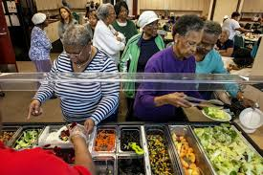
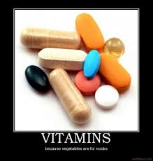
Vitamin Deficiencies in the Elderly
In general, reduced intake and unbalanced diet predisposes people to vitamin and mineral deficiencies.
Drugs affect absorption of vitamins/hepatic metabolism
Smoking interferes with vitamins-especially vit c and folate

Slide 10
Nutritional Assessment in Older Adults
Dietary assessment
24 hour recall
Food records for 7 days
*unintentional weight loss
Clinical Assessment
Wasted , thin, skin, hair, nails, wound healing
Screening tools
MUST-Malnutrition Universal Screening tool
MNA-SF- Mini-nutritional Assessment short form
*Nutrition Screening Initiative
Serum markers-albumin, transferring, serum cholesterol
Notes:
-Serum albumin is a highly predictive serum screening tool-it can predict morbidly and mortality in the elderly (impacted by infection and inflammation)
-Transferrin is also sensitive for early protein energy malnutrition but impacted by other disease
-Low Total serum cholesterol has also been associated with increased risk of malnutrition

Slide 11
Malnutrition Universal Screening Tool
Takes 3-5 minutes
High predictive value in hospital and community environment
Get “risk” score of low,
medium or high
Validated
Developed by the AAFP
and American Dietetic Association

